Slide 1

Students&Companies
RASD/DD project
Andrea Bellani, Alessandro Capellino

Slide 2
Project information
Members
Andrea Bellani:
personal code: 10733192
e-mail: andrea1.bellani@mail.polimi.it
Alessandro Capellino:
personal code: 10744332
e-mail: alessandro.capellino@mail.polimi.it
Project repository URL: https://github.com/ImAndreaBellani/BellaniCapellino

Slide 3
RASD
Requirements And Specification Document

Slide 4

Goals and assumptions
GOALS
[G1] students and companies establish contacts for doing internships
[G2] internships selections can be monitored and supported by the system
[G3] ongoing internships can be monitored from the system

Slide 5

Goals and assumptions
DOMAIN ASSUMPTIONS
[D1] Users must have a reliable internet connection
[D2] Information contained in the CVs are truthful and do not conflict each other
[D3] Company fill the form about internship advice with only information compatible with their business decisions and not conflicting each other
[D4] Company correctly enters the answers provided by the student during the interview into the system
[D5] When users registers, they register with an active email address that belongs to them
[D6] Uploaded CVs are written in EuroPass format

Slide 6

The world and the machine

Slide 7

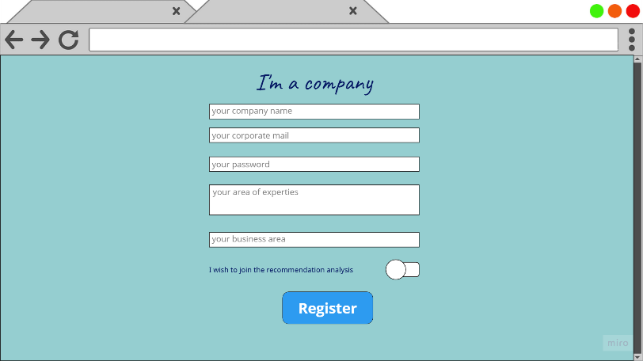
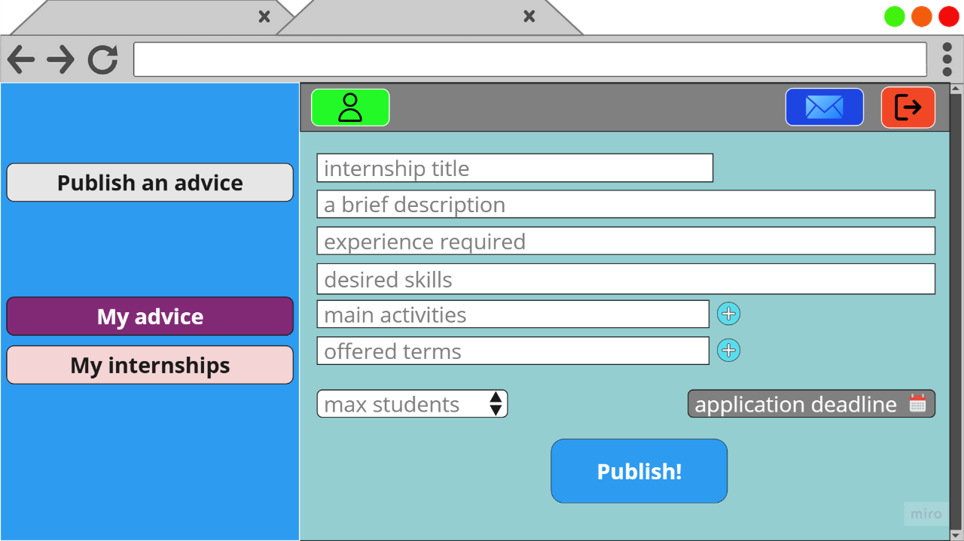

Company advise publish

Slide 8
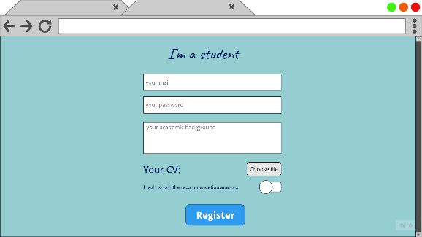
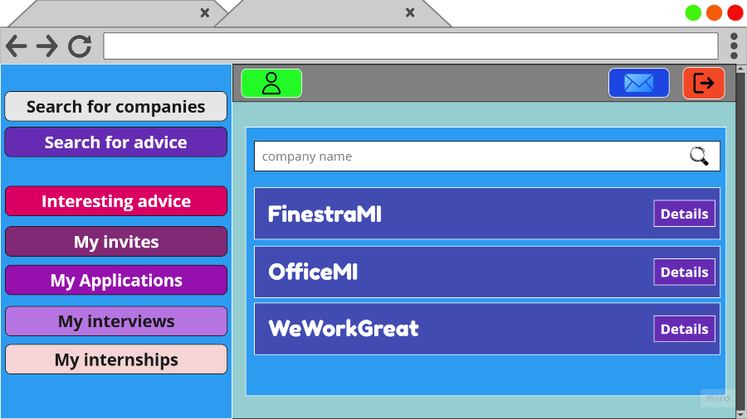

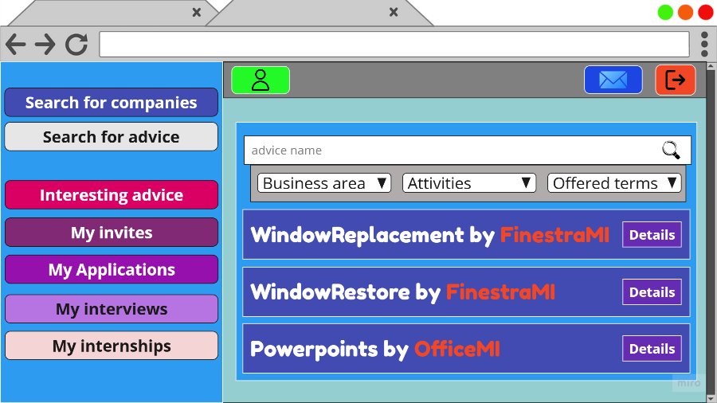
Student proactive search

Slide 9
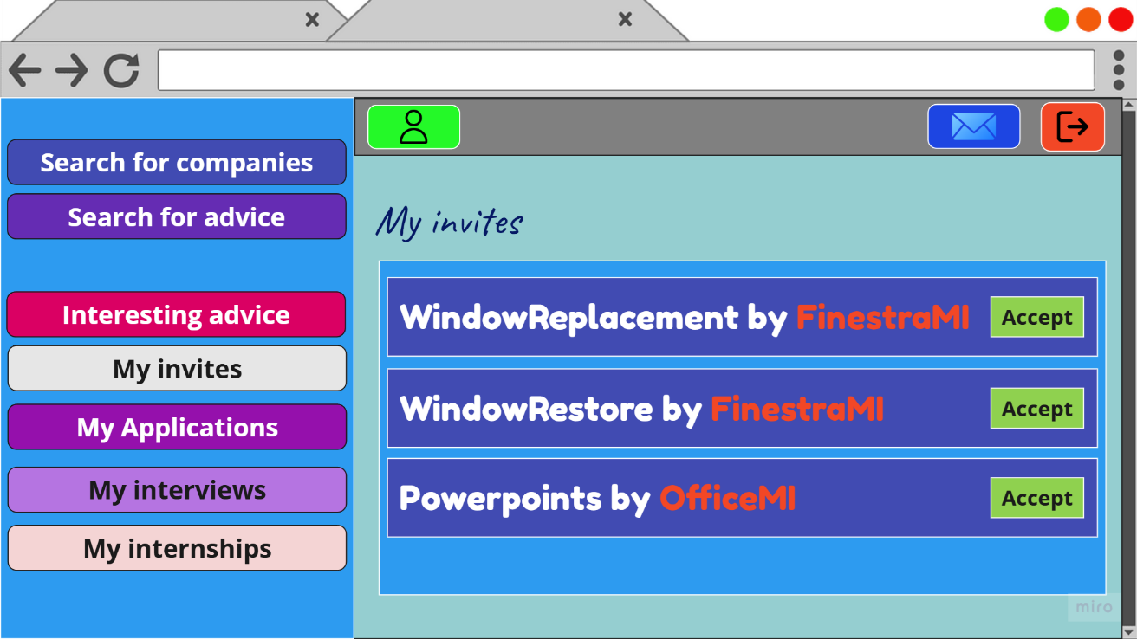
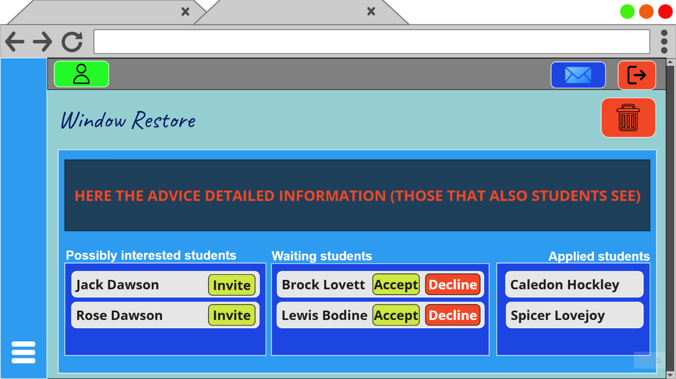


Recommendation mechanism

Slide 10
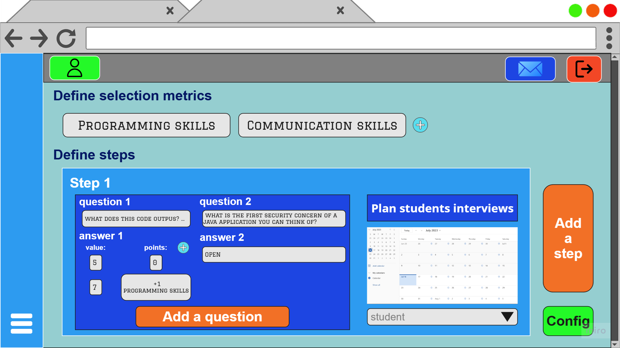
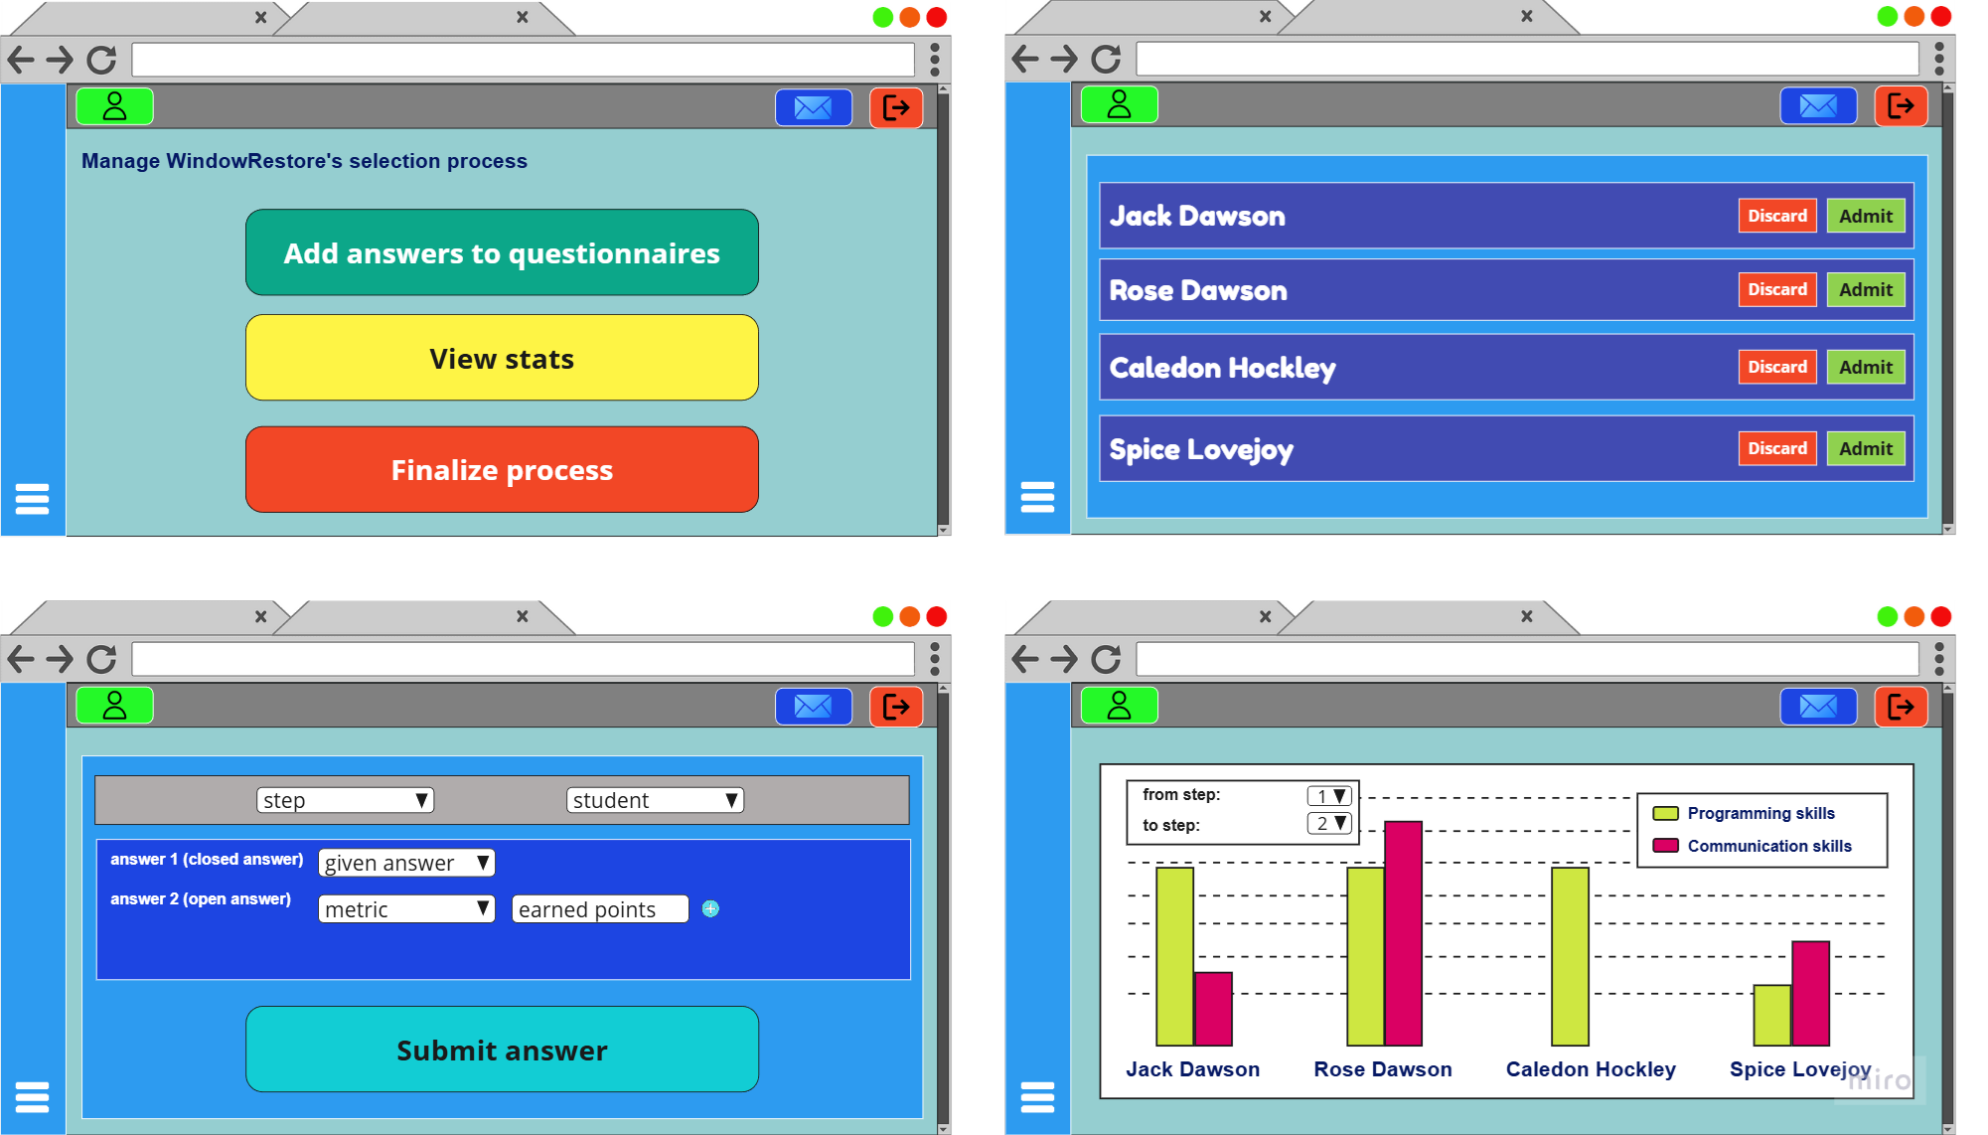
Selection process management

Slide 11
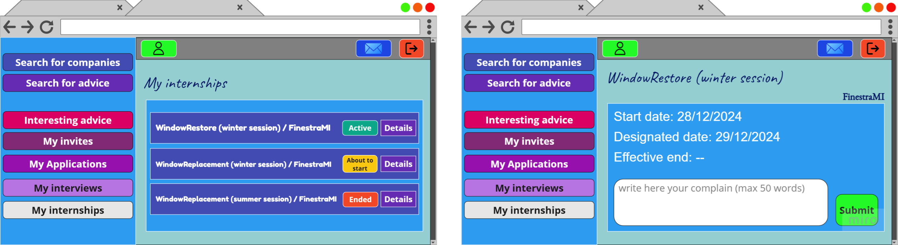

Ongoing internship monitoring

Slide 12
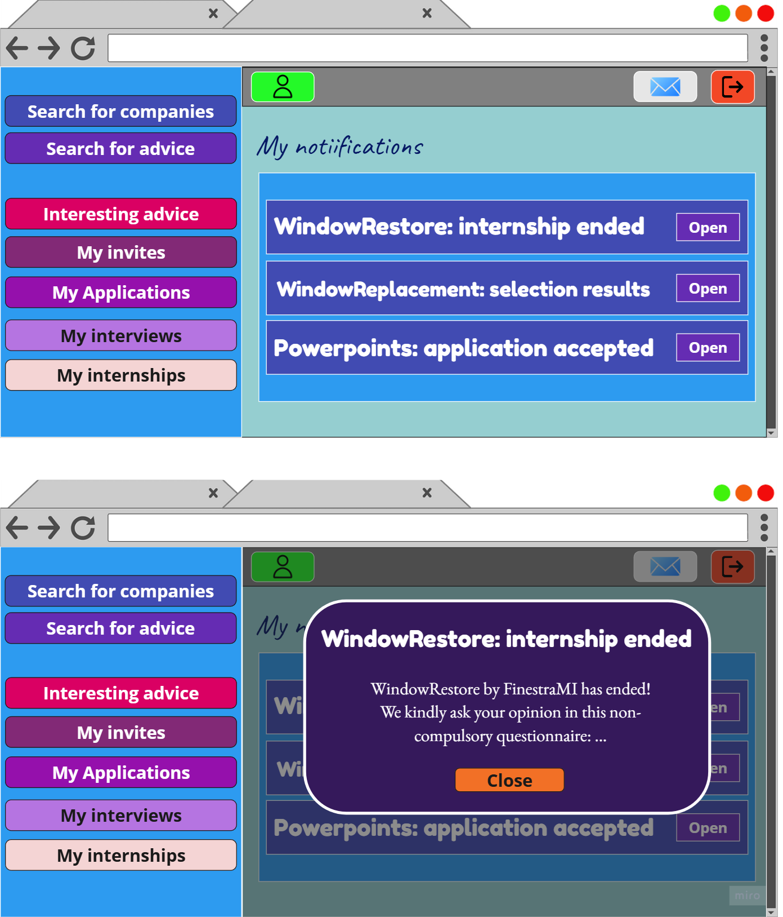
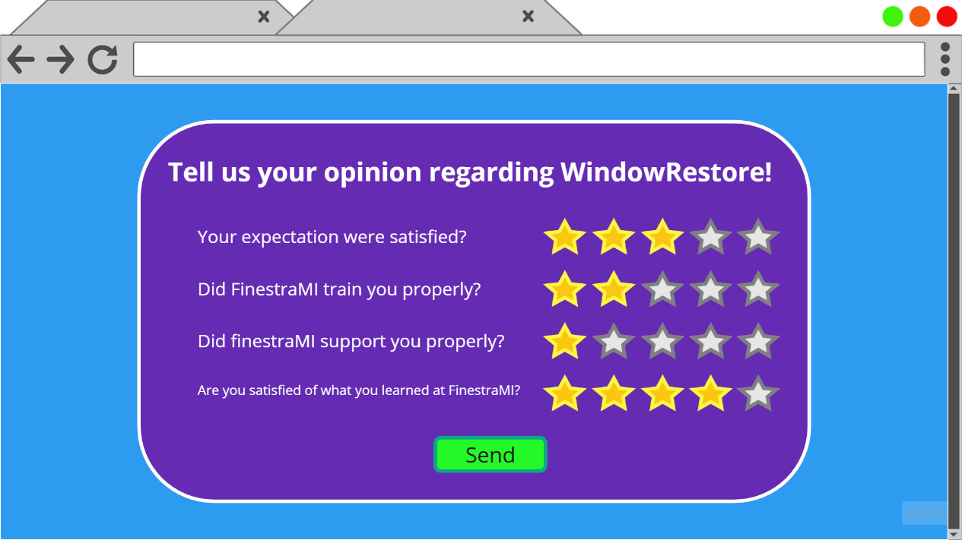
Feedbacks

Slide 13

Our modeling with Alloy 6
What we modeled
applications and withdrawals (temporal simulation)
selection process

Slide 14
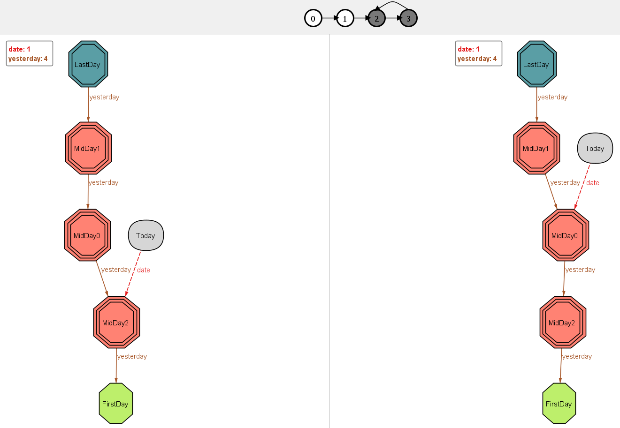
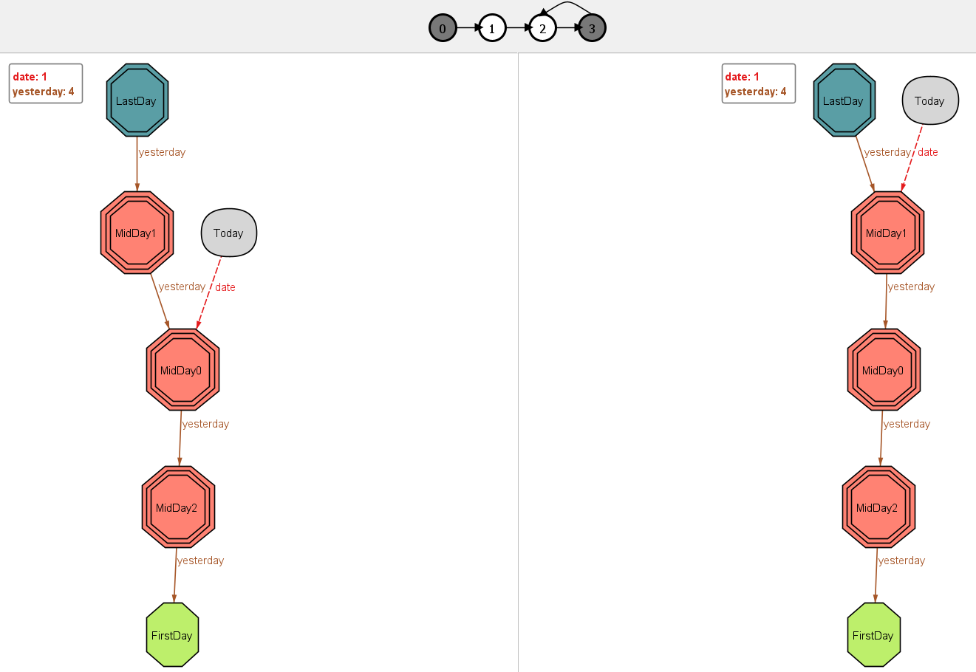

Slide 15
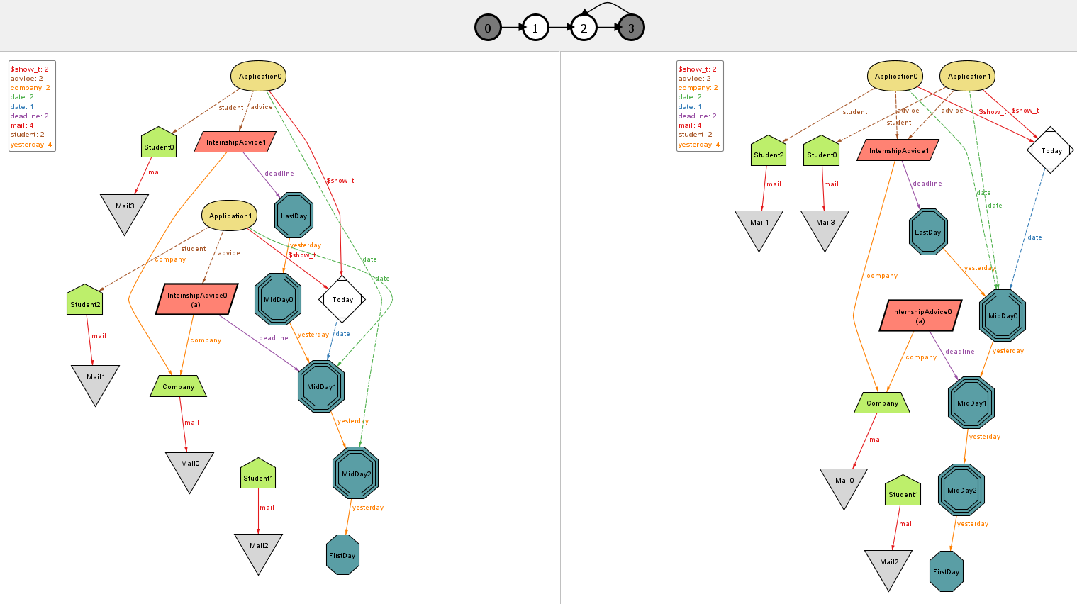

Slide 16
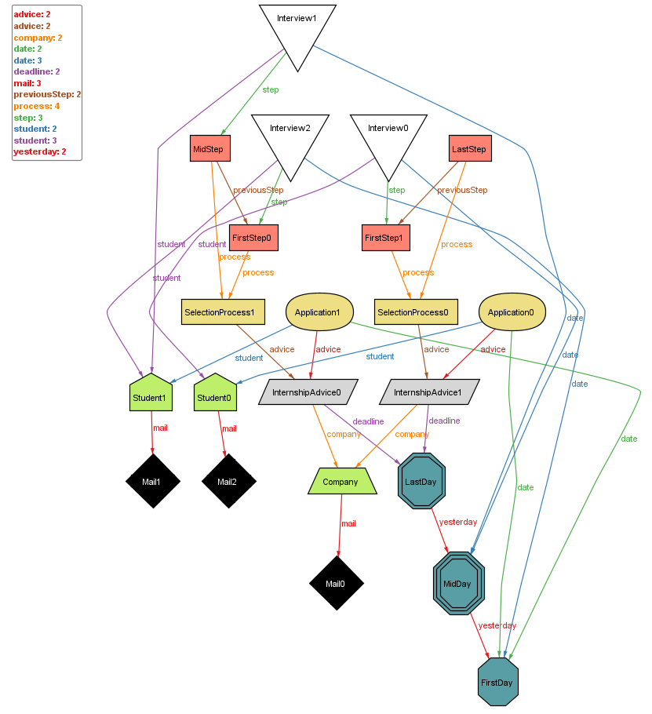

Slide 17
DD
Design Document

Slide 18

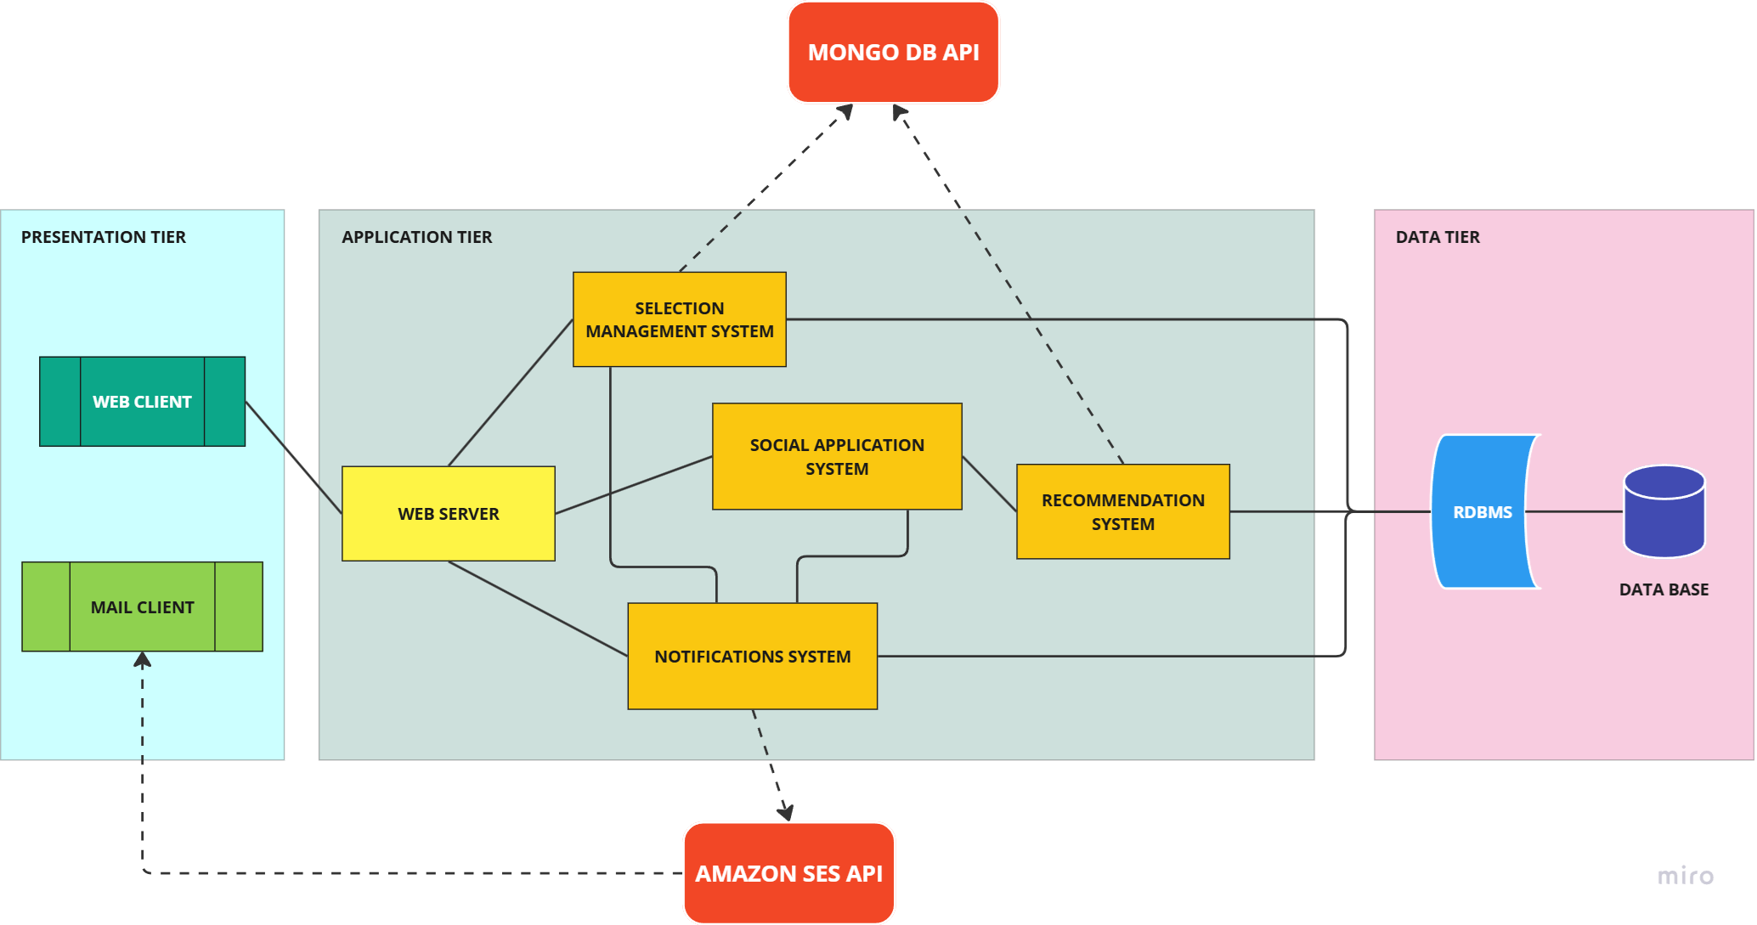
High-level architecture

Slide 19

System components

Slide 20

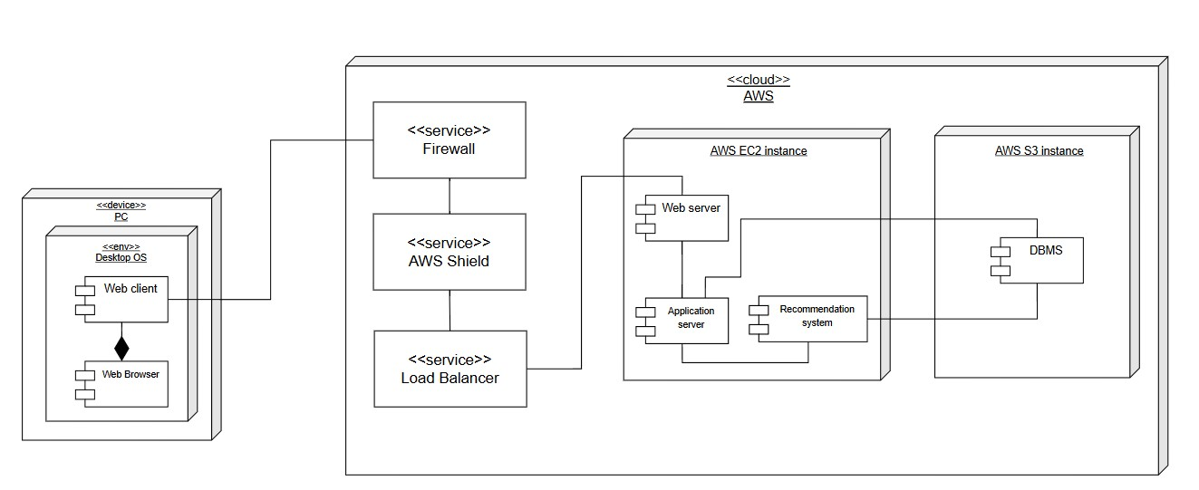
Deployment view

Slide 21

Implemention, Integration and Test Plan

Slide 22
Thank you for your attention
Written by: Andrea Bellani, Alessandro Capellino

